Slide 1

Freelancer
app
Presented by Olivier P Israel, Md Hasan, Aung Latt, Nathan Chen, and Dario Haxhia
LOGO HERE

Slide 2

What is it about ?
This freelance app is primarily designed for skilled tradespeople.
Its purpose is to connect workers in the trades with large
companies, independent contractors, and individuals who need
quick repairs or professional services. The app also helps verify
that each tradesperson is qualified, professional, and properly
licensed.
In addition, less-experienced workers, such as recent trade
school graduates or those who have completed a certain period of
apprenticeship, may also use the app. However, they will be
limited in the number of jobs they can accept until they gain
sufficient experience on the platform. They must also be endorsed
by an experienced professional already registered on the app.

Slide 3


PATHS
Who needs it?
REGION
INVESTOR
Anyone or entities who are in a need of trade-skilled personnel.
Start in the biggest cities (NYC, Miami, Dallas, etc..)
Market needs for skilled-based hiring is at its highest peak.

Slide 4
How will we make money?
$600k
Commission-based fees
Advertisements from local skilled trade companies or trade schools
Late cancellation fees
$500k
$200K
$150K
$200k
Q1
Q2
Q3
Q4

Slide 5
How it works
Four simple steps to get started
STEP
Define your role & set up your profile
👤
01
Choose employer or tradesperson, fill in your basic info, region, and trade speciality
STEP
Upload your documents & get verified
📋
02
Submit your licence, certifications, and ID — juniors also need a senior endorsement
STEP
Post a job or browse available jobs
🔍
03
Employers describe the work needed — tradespeople browse local listings filtered by trade
STEP
Connect, complete & rate the experience
⭐
04
Chat in-app, confirm the job, get it done, and leave a rating to build your reputation
TradeConnect · Skilled trades platform

Slide 6
User journey at a glance
Three personas — one seamless platform
🏢
Employer / Contractor
🔧
Skilled Tradesperson
👷
Junior / Apprentice
1
Open app & select role
1
Open app & select role
1
Open app & select role
2
Verify identity / business
2
Upload licence & certs
2
Upload training docs
3
Describe job & trade needed
3
Set region & availability
3
Get senior endorsement
4
Browse ranked matches
4
Browse & accept jobs
4
Accept within job cap
5
Hire, pay & rate
5
Complete & earn rating
5
Level up over time
TradeConnect · Skilled trades platform

Slide 7
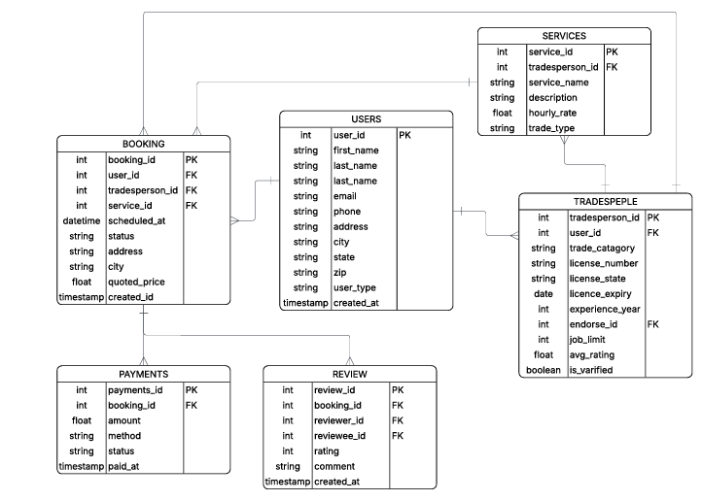
The Data Model

Slide 8
The Stack
Frontend
Next.js
React-based framework · Server-side rendering · Clean UI components
Backend
Python (Flask / FastAPI)
RESTful API · Simple routing · Easy to debug for beginners
Database
MySQL
Relational DB · Native connectors only — NO ORM · Full SQL control
Deployment
Render.com
Backend + frontend deployment · Free tier available · Docker-ready
Reporting
Tableau + Excel Export
Revenue dashboards · One-click Excel export · BI analytics
TradeConnect · Skilled trades platform

Slide 9
Member Roles
> API Development
> Security
> Authentication
> Server Logic
> Performance Optimization
> Team Lead
> Deployment
> Integration > Backend Assist
> Database Assist
> Frontend Assist
> User Interface
>User Experience
> Responsive Design
> Dynamic Interaction
> State Management
Olivier P Israel
Md Hasan
Aung Latt
Nathan
Dario
> Django Rest framework
> Create login page
> Develop the ratings and reviews.
> Implement a notification service.
> Design MySQL database structure
>Create normalized tables (2NF)
>Write SQL queries for data operations
>Assist with database integration
Note: Roles are flexible — members may share responsibilities across areas
TradeConnect · Skilled trades platform

Slide 10
Q&A

